Slide 1
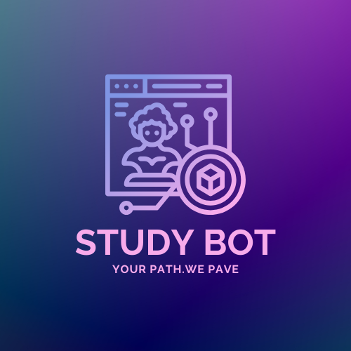
Course Recommendation -STUDY BOT
Name: Varun.S, Venkatesh.D, Dharani Krishna
Roll No: 71762332006,54,56
Course : M.Sc. Data Science

Slide 2
PROBLEM STATEMENT
Students face difficulties navigating vast educational content without personalized guidance or collaborative tools. Existing platforms, like Duolingo, focus on individual progress but lack features that adapt to each learner's needs or encourage peer interaction.
2

Slide 3




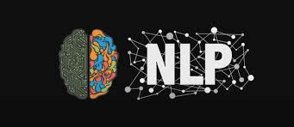
TECHNOLOGIES :

Slide 4
MAIN OBJECTIVES :
To build a web application that provides personalized learning paths and fosters collaborative learning,Dynamic databases

Slide 5
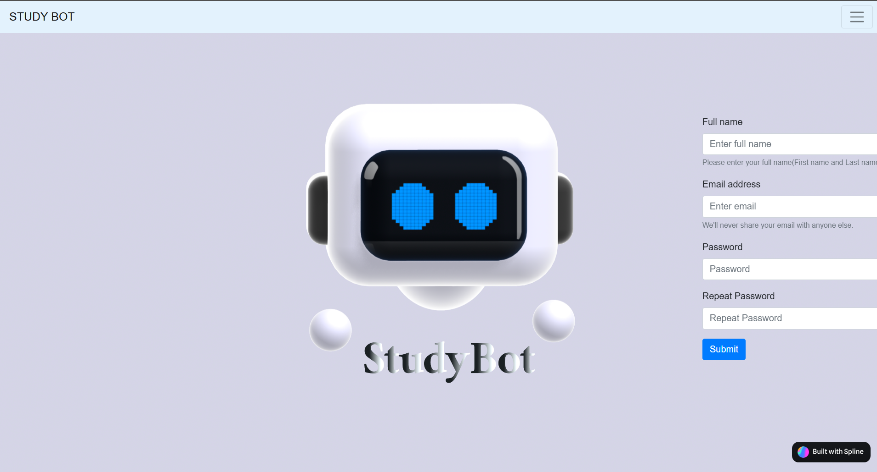
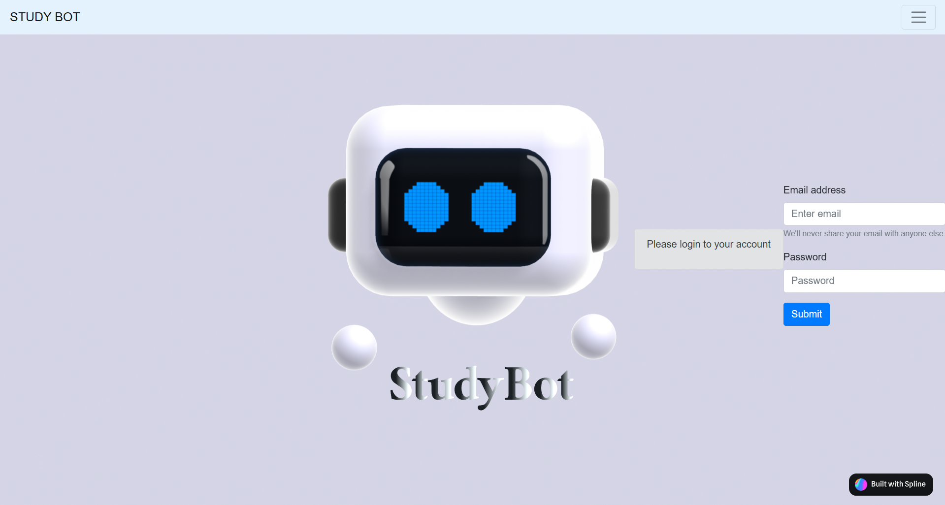
CREDENTIAL PAGE
REGISTRATION PAGE
LOGIN PAGE

Slide 6
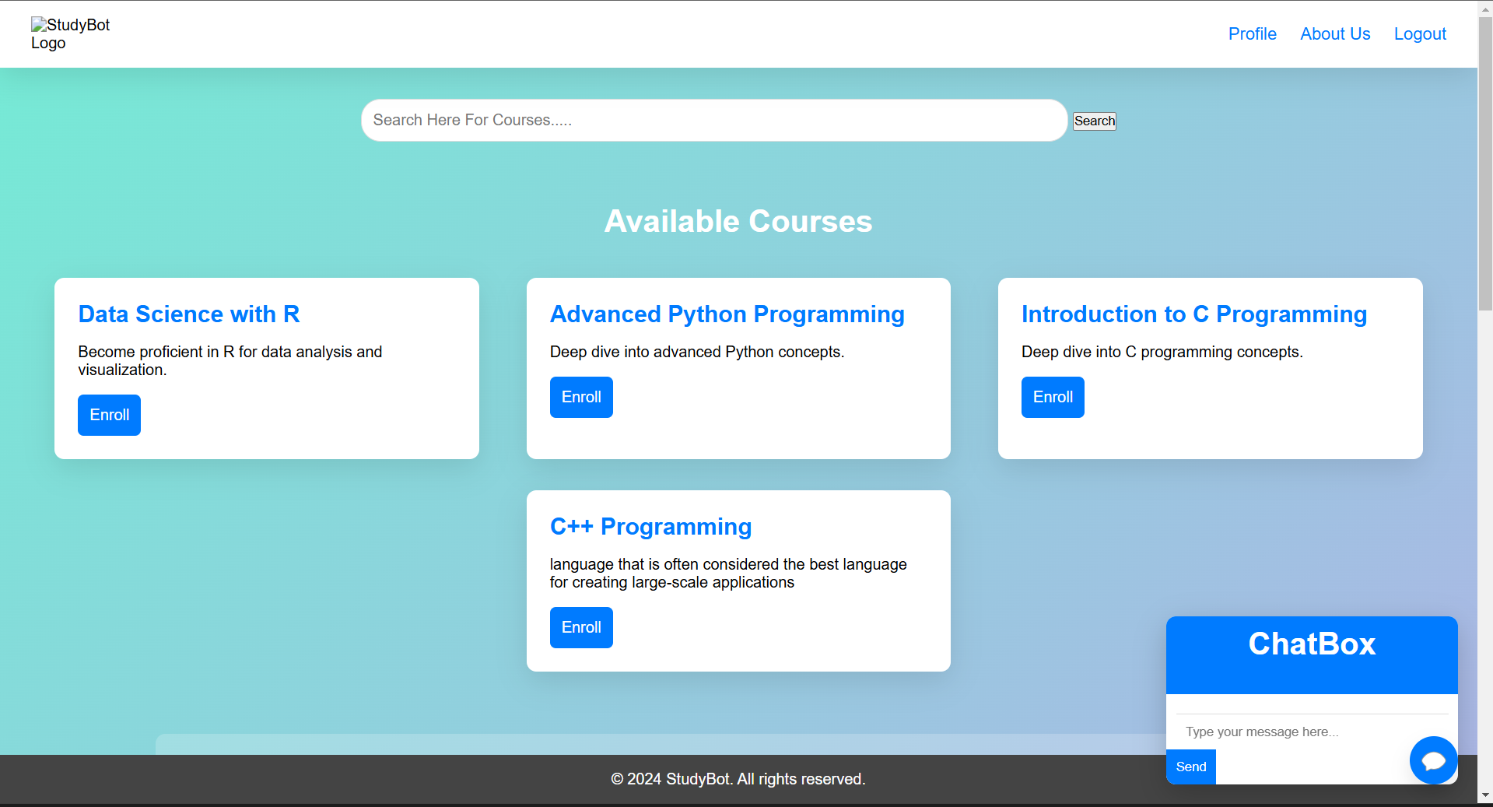
HOME PAGE

Slide 7
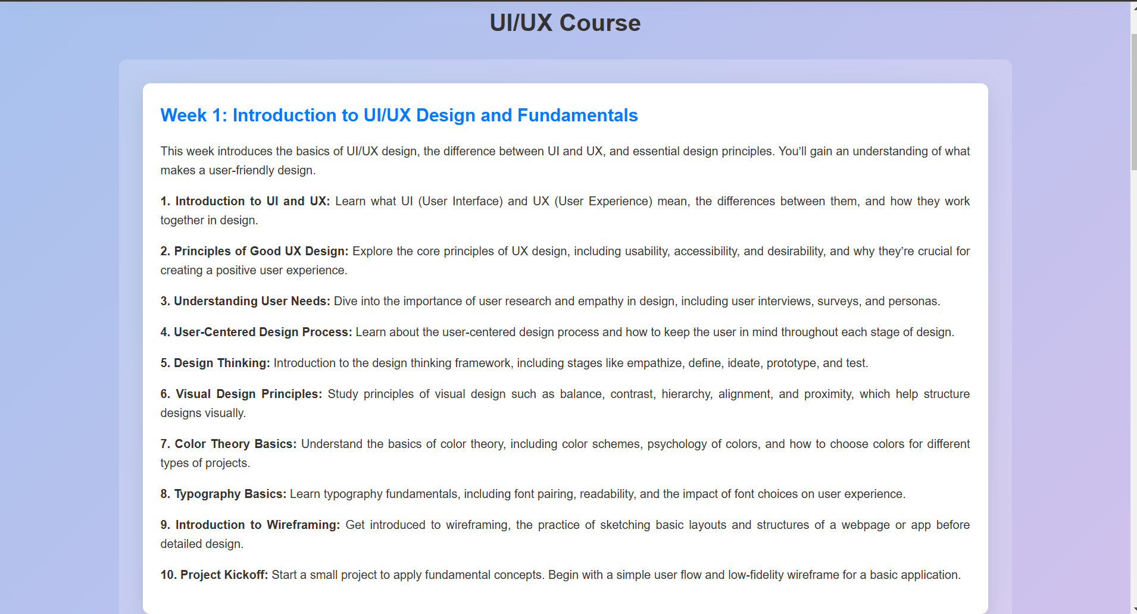
COURSE PAGE

Slide 8
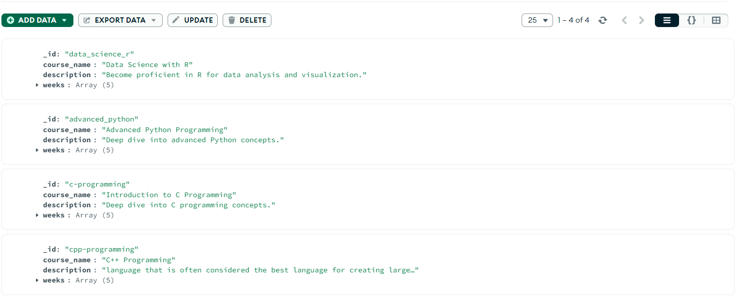
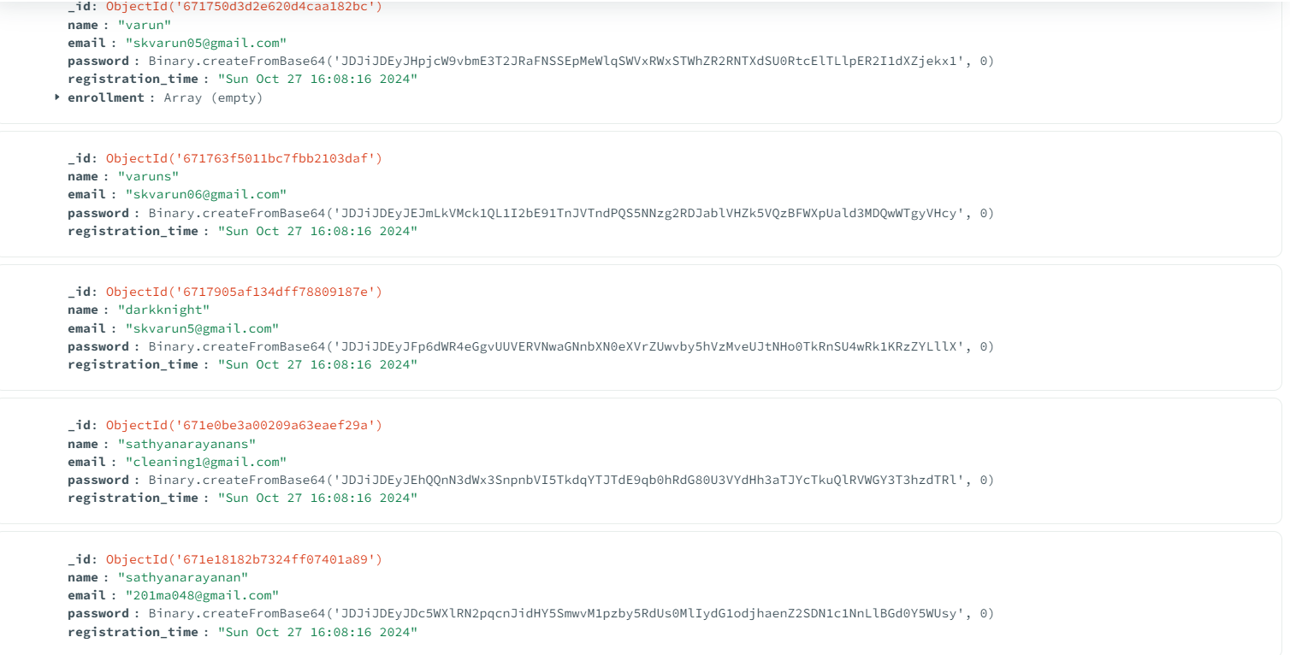
DATABASE
COURSE DATABASE
USER DATABASE

Slide 9
NLP Libraries :
Scikit-learn:
Scikit-learn is a powerful and widely-used machine learning library in Python that provides tools for data mining and data analysis.
NLP Components Used:
TfidfVectorizer
cosine_similarity

Slide 10
Scalability & Feasibility :
Built with scalable technologies (Flask/ MongoDB), the platform can handle large user bases and grow with demand. In Future, We like to add AI-driven, real-time collaboration, Cloud service makes it feasible for diverse subjects and audiences.

Slide 11
Advantages:
Personalized Learning Paths
Real-Time Collaboration
Enhanced Motivation
Scalability and Feasibility
Self-Paced Learning Period
Engaging Study Time
Precise and Clear Pathway Through Courses

Slide 12
Conclusion :
This project aims to create a personalized, adaptive, and collaborative learning platform that addresses the gaps in existing e-learning systems, ensuring an engaging and supportive learning experience for all users.

Slide 13
THANK YOU!

